Slide 1
Chapter 9
The Confederation and the Constitution (1776-1790)

Slide 2
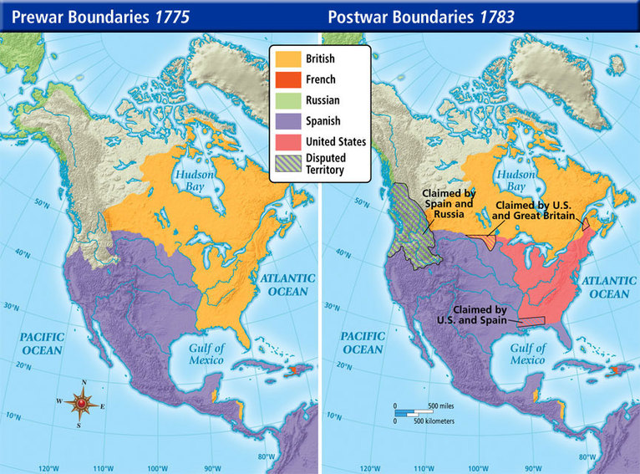
Ch. 8 Review – The End ONLY!
Treaty of Paris 1783, officially ends the Revolutionary War (Franklin, J. Adams, J. Jay).
The United States was granted land as far west as the Mississippi and as far north as the Great Lakes.
Loyalist lands were returned, and the United States agrees to not interfere with Britain collecting debts from Americans.

Slide 3
A New Nation Legitimized
Why such generous terms?
To keep the Americans on the side from getting too close with the French (Napoleon).
The French didn’t object to the treaty as they were happy to have to stop spending money on the conflict.

Slide 4
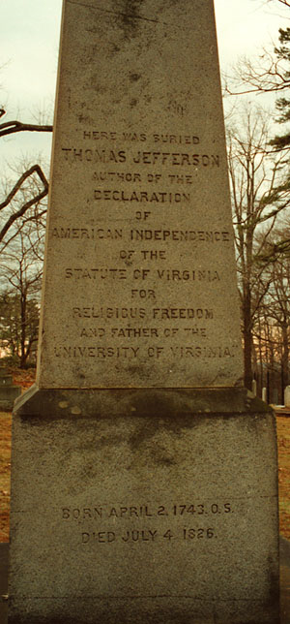
Ideas after American Revolution
Republican Motherhood:
Women were to raise children to be good citizens of the United States
Virginia Statute of Religious Freedom:
Created by Jefferson, religious freedom, influences the Bill of Rights
Popular Sovereignty:
Idea that people are the source of power and have a say in government

Slide 5
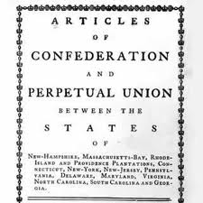
Articles of Confederation
First governing document of the United States
Adopted in 1777
States claiming western lands had to surrender them to national government
Helped convince France of legitimate government in the making
***NO STRONG CENTRAL GOVERNMENT***
To amend the Articles, all 13 states’
approval was necessary

Slide 6
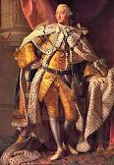
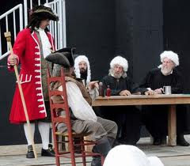
Negatives of Articles
No executive branch
Weak judicial branch
Each state has single, equally powerful vote
Conflict between large and small states
Congress could not enforce tax collection
Why?

Slide 7
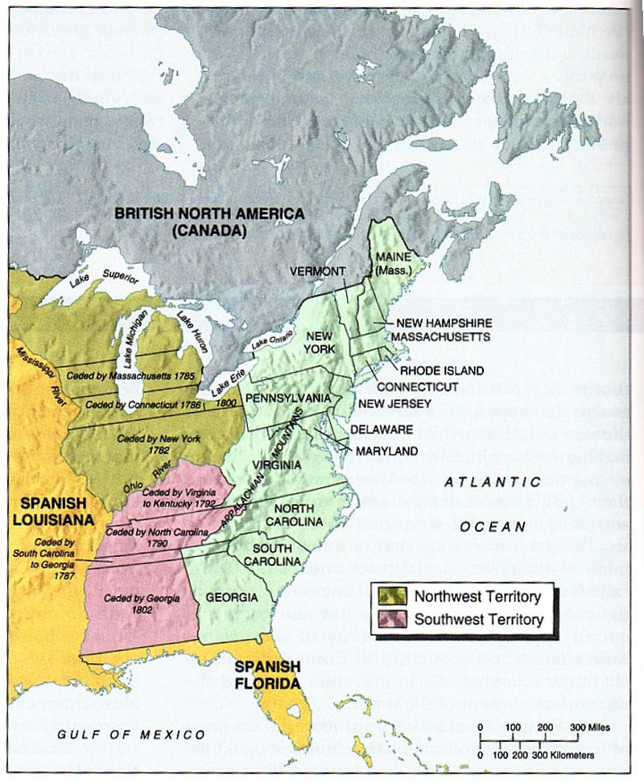
Positives of Articles
Clearly defined powers:
Create post offices
Committees of correspondence?
Land Ordinance of 1785:
Divided up land in Northwest, sold it to raise money
Northwest Land Ordinance of 1787:
Process of admitting territories into union
Prohibited slavery in old northwest
CONFLICT BETWEEN NORTH AND SOUTH!!

Slide 8

International Challenges
Britain: closed West Indies trade, encouraged Natives to raid colonist towns
Spain: Closed Mississippi River, also sided with Natives
Mediterranean: Pirates (Barbary) were attacking American ships
France: Demanded repayment of loans, restricted West Indies trade

Slide 9

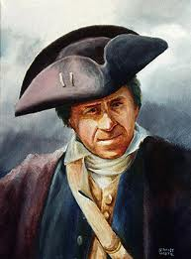
Shays’ Rebellion
Former military man, Daniel Shay leads a rebellion made up of poor farmers. Sound familiar?
Wanted lower taxes
Wanted banks to stop foreclosing on homes
Rebellion was eventually crushed, but showed that America needed a STRONG CENTRAL GOVERNMENT THAT WAS NOT PROVIDED BY THE ARTICLES OF CONFEDERATION!!!

Slide 10
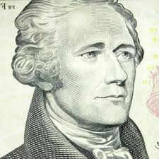
Conventions
Annapolis Convention: Led by A. Hamilton, only 5 states show up, promise to meet next year to revise A of C
Philadelphia Convention: purpose to revise A of C, end up creating a brand new governing document called…………
THE CONSTITUTION

Slide 11
Compromises
Virginia Plan (Large State)
Representation in Congress should be based on population
New Jersey Plan (Small State)
Representation in Congress should be equal
Great Compromise: (Connecticut Compromise) Roger Sherman
2 house (bicameral) legislature: 1 based on population (House of Representatives), 1 equal per state (Senate)

Slide 12
More Constitution stuff
South wanted slaves to count as population, north didn’t
3/5 Compromise:
60% of slaves will count towards population in the house
BUT they cannot vote!
Slave Trade Compromise: slave trade can continue until end of 1807
How does the end of the slave trade affect slaves?

Slide 13
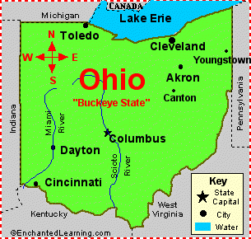
Still more stuff…………
Electoral College:
Used to elect the President rather than popular vote
Popular vote winner in each states wins electoral votes
The Elastic Clause (Necessary and Proper):
Congress shall have the power to… make all Laws which shall be necessary and proper for carrying into Execution the foregoing Powers…"
18

Slide 14
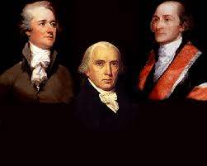
Ch. 9 Review: Federalists vs. Anti-federalists
Federalists: In favor of a strong central government (Madison, Hamilton, Washington, Jay, etc.)
Adult language present.
Anti-Federalists: In favor of a weaker central government with states having more power (Sam Adams, Patrick Henry)
Why did Anti-Federalists adopt the Constitution?
Federalists promised to add a Bill of Rights!!!!
Federalists Papers: pamphlet to gather support for the Constitution

